Slide 1



NLP: Conversational Bots: ChatBots
Conversational bots, or chatbots, are AI-powered applications that can engage in natural language interactions with users. These projects involve building chatbots that can understand and respond to user input, providing a personalized and engaging experience.
S Dhana Prakash
192211128
SSE,SIMATS

Slide 2

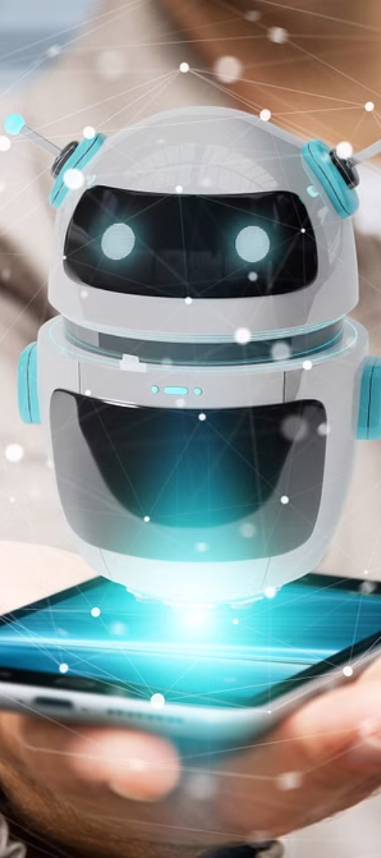
Objective of Project:
1
Enhance User Experience
2
Showcase NLP Capabilities
Develop chatbots that can assist users with tasks, answer questions, and provide personalized information in a natural, conversational way.
Leverage natural language processing techniques to enable the chatbot to understand and interpret user input effectively.
3
Improve Customer Service
Deploy chatbots to handle common customer inquiries and provide 24/7 support, freeing up human agents for more complex tasks.

Slide 3
Understanding Natural Language Processing (NLP)
Language Understanding
Language Generation
Dialogue Management
Develop models that can comprehend and interpret natural language, including common phrases, idioms, and contextual cues.
Create models that can generate coherent and natural-sounding responses based on user input and the desired conversational context.
Implement techniques to manage the flow of the conversation, keeping track of the context and providing appropriate responses.

Slide 4

Data
1
Conversational Datasets
Collect and utilize existing datasets of human-to-human conversations, such as customer service transcripts or online chat logs.
2
Domain-Specific Data
Gather data related to the specific domain or industry that the chatbot will be serving, such as product information or FAQs.
3
User Interaction Data
Continuously collect and analyze user interactions with the chatbot to improve its performance and expand its knowledge base.

Slide 5



Preprocessing and Cleaning
Text Preprocessing
Data Cleaning
Feature Engineering
Perform tasks such as tokenization, lemmatization, and stop word removal to prepare the data for model training.
Identify and address any issues with the data, such as typos, inconsistencies, or irrelevant information.
Extract relevant features from the text data that can be used to train more accurate and efficient models.

Slide 6




Building Chatbot Models
Encoder-Decoder Models
Utilize seq2seq models, such as LSTM or Transformer-based architectures, to encode user input and generate appropriate responses.
Retrieval-Based Models
Develop models that can match user queries to a database of pre-written responses, providing relevant and consistent answers.
Hybrid Approaches
Combine retrieval-based and generative models to leverage the strengths of both approaches for more robust and versatile chatbots.

Slide 7
Deployment and Evaluation
Deployment Platforms
Integrate the chatbot with popular messaging apps, websites, or voice assistants for widespread accessibility.
Evaluation Metrics
Measure the chatbot's performance using metrics such as response accuracy, user satisfaction, and task completion rates.
Continuous Improvement
Regularly gather feedback from users and update the chatbot's knowledge base and conversational abilities.

Slide 8
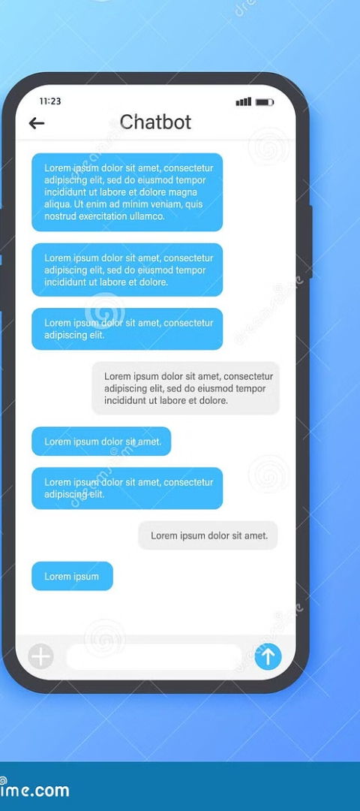
Outcome
Conversational Interface
Automated Assistance
A user-friendly chatbot that can engage in natural, human-like dialogue, providing a more intuitive and enjoyable interaction.
A chatbot that can efficiently handle a wide range of user queries and tasks, improving overall productivity and efficiency.
Scalable Solution
A chatbot that can be easily deployed and scaled to serve a large number of users, making it a cost-effective solution for businesses.

Slide 9
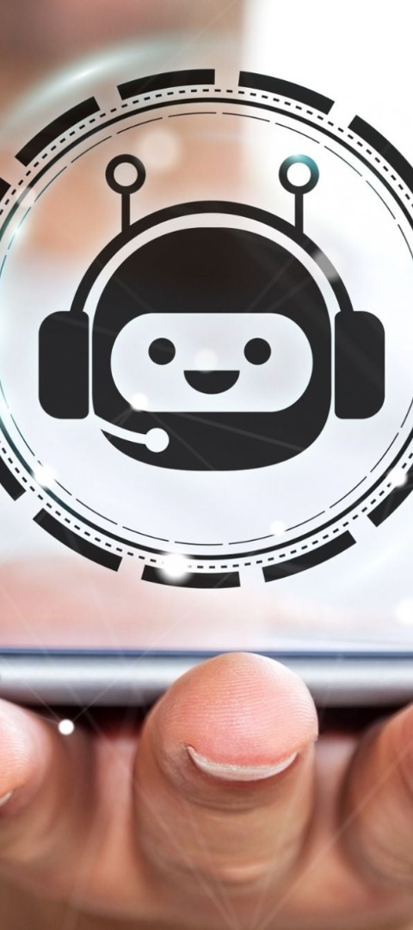
Conclusion
1
Exciting Possibilities
2
Ongoing Challenges
Conversational bots offer exciting opportunities to enhance user experiences and showcase the capabilities of natural language processing.
Developing truly intelligent and engaging chatbots requires overcoming challenges in areas like contextual understanding and open-ended dialogue.
3
Continued Innovation
As NLP techniques continue to advance, the potential for more sophisticated and versatile chatbots will only grow, transforming how we interact with technology.

